Slide 1
The Rational Decision
Making Process
Presented by:
Md.Redoan Ahammd
182002045
Afsana Kabir Sinthia Razia Sultana Urmi
182002068 182002079
Sonia Chowdhury Sinthiya Asmaul Husna Rima
182002026 182002003

Slide 2





Snapshot
Introduction
Process of decision making
Steps of
Decision making
Example
And Benefits
Conclusion

Slide 3
Introduction
Decision making involves the selection of a course of action from among two or more
possible alternatives in order to arrive at a solution for a given problem.
Being the opposite of intuitive decision making, rational model of decision making is a model where individuals use facts and information, analysis, and a step-by-step procedure to come to a decision. The rational model of decision making is a more advanced type of decision-making model.
Two main steps are important for personal decision making,
Establishing the Goal or Objective
Evaluation of Feasible Alternatives
For example: Here if any student wants to admit in a University. In this table, we are showing different alternatives in decision making.

Slide 4


University choice example
FOOD
FIELD
STUDENT
FEES
HOSTEL
RANK
CITY
Quality
Football , cricket
Amount of student
Cost of study
Hostel facility
UNIVERSITY RANK
Which city
University 1
University 2
More efficient
Costly and not efficient

Slide 5
Process of Decision Making
Decision making is the process of making choices by identifying a decision, gathering information, and assessing alternative resolutions.
Using a step-by-step decision-making process can help you make more deliberate, thoughtful decisions by organizing relevant information and defining alternatives. This approach increases the chances that we will choose the most satisfying alternative possible.

Slide 6



PROCESS STEPS
Identify the decision
Gather relevant information
Identify the alternatives
Weigh the evidence
Choose among alternatives
Take action

Slide 7
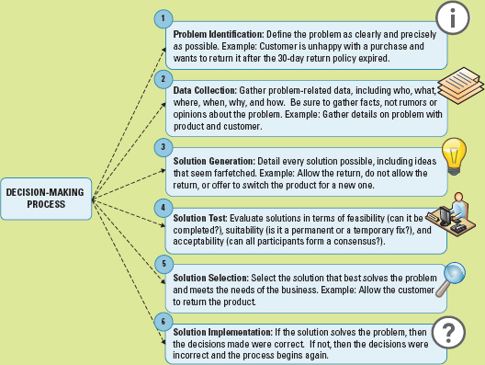
Example

Slide 8
Benefits
The main strength of a rational decision-making model is that it provides structure and discipline to the decision-making process.
It helps ensure we consider the full range of factors relating to a decision, in a logical and comprehensive manner. These are a key feature of our comprehensive guide: Making Better Decisions.

Slide 9
Conclusion
The rational choice approach allows preferences to be represented as real-valued utility functions. Economic decision making then becomes a problem of maximizing this utility function, subject to constraints . This has many advantages. It provides a compact theory that makes empirical predictions with a relatively sparse model - just a description of the agent's objectives and constraints. Most importantly, this approach is strikingly general. It has been used to analyze not only personal and household choices about traditional economic matters like consumption and savings, but also choices about education, marriage, child-bearing, migration, crime and so on, as well as business decisions about output, investment, hiring, entry, exit, etc. with varying degrees of success.

Slide 10
With the right policies and timely action, Decision can make Huge changes toward success.

Slide 11
THANK YOU

